Slide 1
Linee guida endoscopiche
Matteo Monami
Aou-careggi- firenze

Slide 2
Titolo presentazione
arial bold 8 pt
Luogo e data arial regular 8 pt
Conflitti di interessi
Negli ultimi due anni, M. Monami ha ricevuto:
compensi per relazioni a corsi/convegni da Sanofi e Zuccato srl
compensi da agenzie in simposi sponsorizzati da Boehringer Ingelheim, Eli Lilly, Mundipharma, Novo Nordisk, Sanofi e Takeda

Slide 3
Titolo presentazione
arial bold 8 pt
Luogo e data arial regular 8 pt
AGREE (Appraisal of Guidelines for Research and Evaluation) - II
DOMAIN 1: SCOPE AND PURPOSE
de Luca et al., Updates in Surgery, ahead-of print, 2024

Slide 4
Titolo presentazione
arial bold 8 pt
Luogo e data arial regular 8 pt
AGREE (Appraisal of Guidelines for Research and Evaluation) - II
DOMAIN 2: STAKEHOLDER INVOLVEMENT
de Luca et al., Updates in Surgery, ahead-of print, 2024

Slide 5
Titolo presentazione
arial bold 8 pt
Luogo e data arial regular 8 pt
DOMAIN 3: RIGOUR OF DEVELOPMENT
GRADE
(Grading of Recommendations Assessment, Development and Evaluation)
RCT e/o OBS
Guyatt G et al. J Clin Epidemiol 64:383-94, 2011

Slide 6
Titolo presentazione
arial bold 8 pt
Luogo e data arial regular 8 pt
PICO

Slide 7
Titolo presentazione
arial bold 8 pt
Luogo e data arial regular 8 pt
PICO

Slide 8
Titolo presentazione
arial bold 8 pt
Luogo e data arial regular 8 pt
PICO

Slide 9
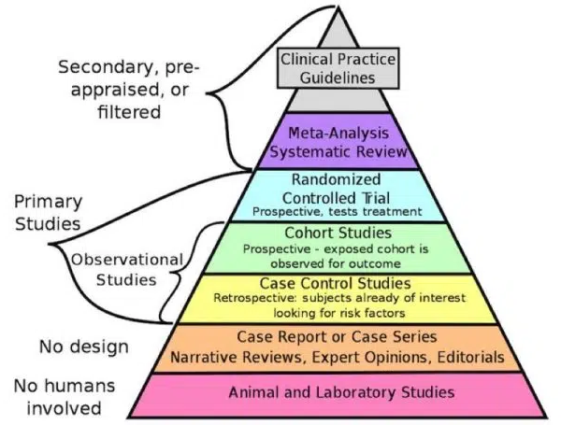
Titolo presentazione
arial bold 8 pt
Luogo e data arial regular 8 pt
AGREE (Appraisal of Guidelines for Research and Evaluation) - II
DOMAIN 3: RIGOUR OF DEVELOPMENT
1. Systematic methods were used to search for evidence.
2. There is an explicit link between the recommendations and the supporting evidence.
3. The guideline has been externally reviewed by experts prior to its publication.
4. A procedure for updating the guideline is provided.

Slide 10
Titolo presentazione
arial bold 8 pt
Luogo e data arial regular 8 pt
Indication to endoscopic bariatric surgery: BMI 27-29.9 Kg/m2
Outcome 1: BMI, reduction
No trials retrieved
Unpublished data

Slide 11
Titolo presentazione
arial bold 8 pt
Luogo e data arial regular 8 pt
Indication to endoscopic bariatric surgery: BMI 30-34.9 Kg/m2
Outcome 1: BMI, reduction
Unpublished data

Slide 12
Titolo presentazione
arial bold 8 pt
Luogo e data arial regular 8 pt
Indication to endoscopic bariatric surgery: BMI 35-39.9 Kg/m2
Outcome 1: BMI, reduction
Unpublished data

Slide 13
Titolo presentazione
arial bold 8 pt
Luogo e data arial regular 8 pt
Indication to endoscopic bariatric surgery: insufficient weight loss/regain
Outcome 1: BMI, reduction
Unpublished data

Slide 14
The Eminence Based Medicine

Slide 15
The Evidence Based Medicine

